Slide 1
Capstone Project
SGEMM GPU Kernel Performance
Presentation by
Pendiyala Sai Kumar

Slide 2
Prephase
Problem Statement
Introduction
Data Understanding
Architecture
Exploring Data Analysis
Feature Engineering
Model Implementation
Model Explainability
Conclusions

Slide 3
Problem Statements
Checking efficiency of SGEMM GPU kernel performance with the help of independent variables, (explanatory variables) giving some arithmetic calculation like matrices multiply with other matrix and it was measured by multiple runtime's how fast it was calculated. TO predict the dependent variables (response variables) from the actual values.

Slide 4
Introduction
This data set measures the running time of a matrix-matrix product
A∗B=C, where all matrices have size 2048 x 2048, using a parameterizable SGEMM GPU kernel with 241600 possible parameter combinations. For each tested combination, 4 runs were performed and their results are reported as the 4 last columns. All times are measured in milliseconds.

Slide 5
Data Understanding
There are 14 parameter, the first 10 are ordinal and can only take up to 4 different powers of two values, and the 4 last variables are binary. Out of 1327104 total parameter combinations, only 241600 are feasible (due to various kernel constraints). This data set contains the results for all these feasible combinations.
Independent variables:
MWG, NWG: per-matrix 2D tiling at workgroup level: {16, 32, 64, 128} (integer)

Slide 6
Data Understanding
Independent variables:
KWI: kernel loop unrolling factor: {2, 8} (integer)
VWM, VWN: per-matrix vector widths for loading and storing: {1, 2, 4, 8} (integer)
KWG: inner dimension of 2D tiling at workgroup level: {16, 32} (integer)
MDIMC, NDIMC: local workgroup size: {8, 16, 32} (integer)
MDIMA, NDIMB: local memory shape: {8, 16, 32} (integer)

Slide 7
Data Understanding
STRM, STRN: enable stride for accessing off-chip memory within a single thread: {0, 1} (categorical)
SA, SB: per-matrix manual caching of the 2D workgroup tile: {0, 1} (categorical)
Dependent variables:
Run1, Run2, Run3, Run4: performance times in milliseconds for 4 independent runs using the same parameters. They range between 13.25 and 3397.08.

Slide 8
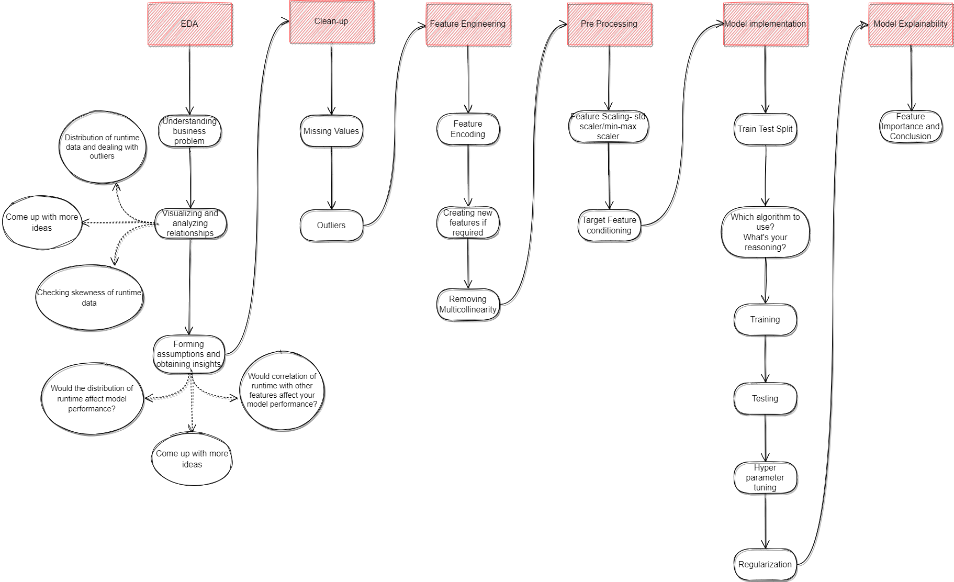
Architecture

Slide 9
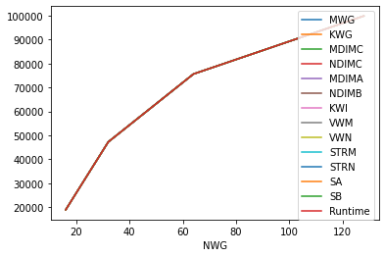
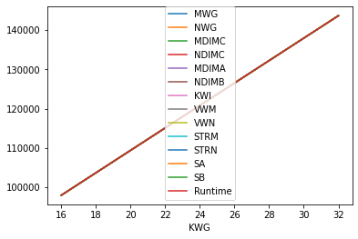
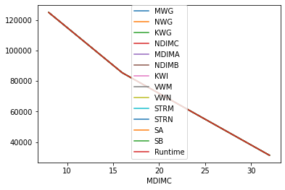

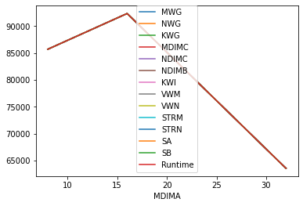

Exploring Data Analysis
Analysing Runtime performance

Slide 10
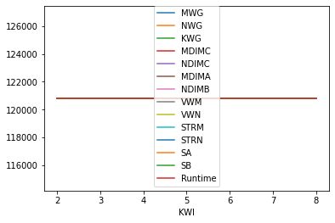
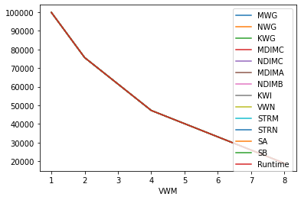
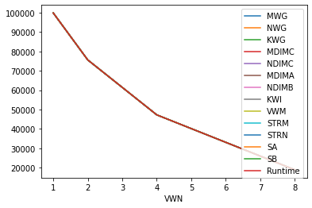
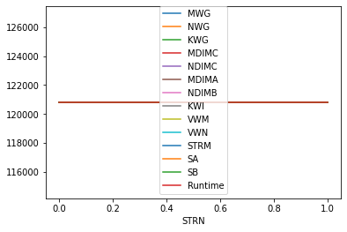
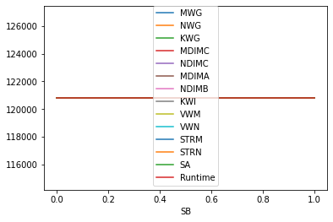
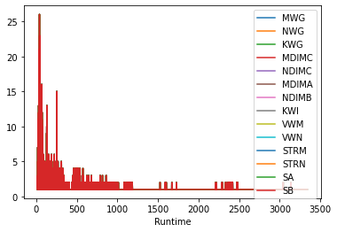
Exploring Data Analysis

Slide 11
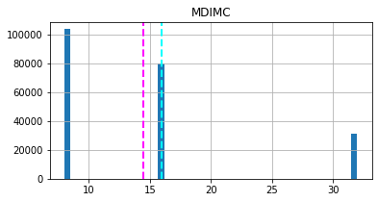
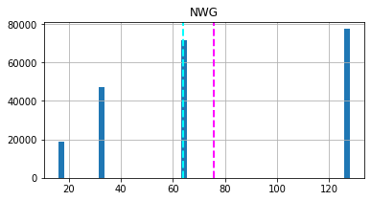
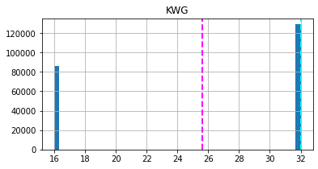
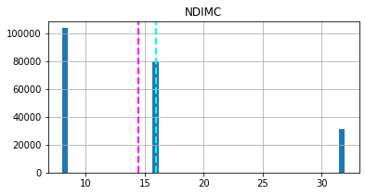
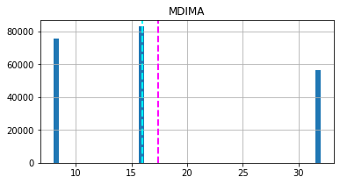
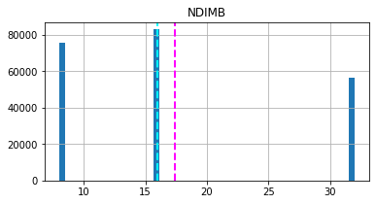
Exploring Data Analysis

Slide 12
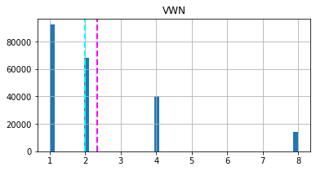
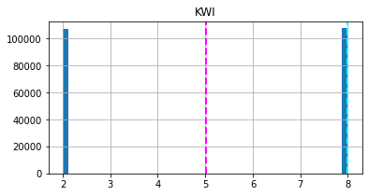
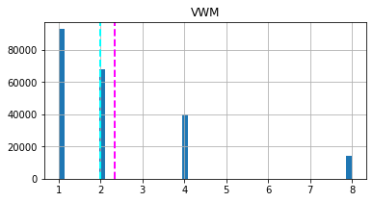
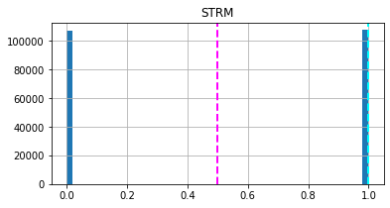
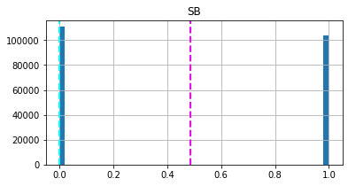
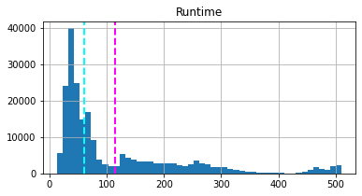
Exploring Data Analysis

Slide 13
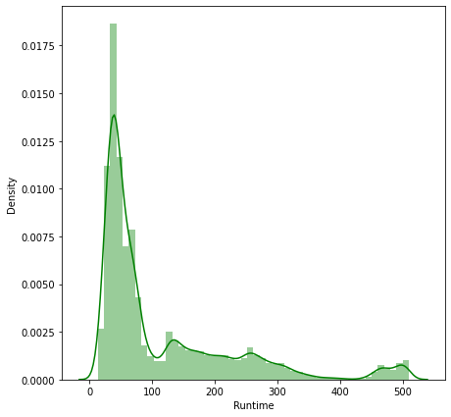
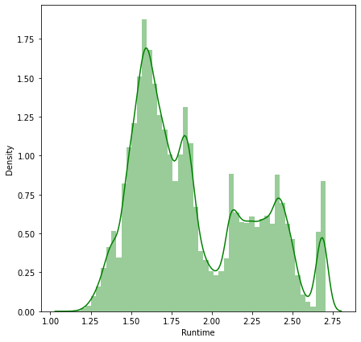
Exploring Data Analysis
Analysing SGEMM GPU Kernel Performance using Distribution plot before and after logarithm.

Slide 14
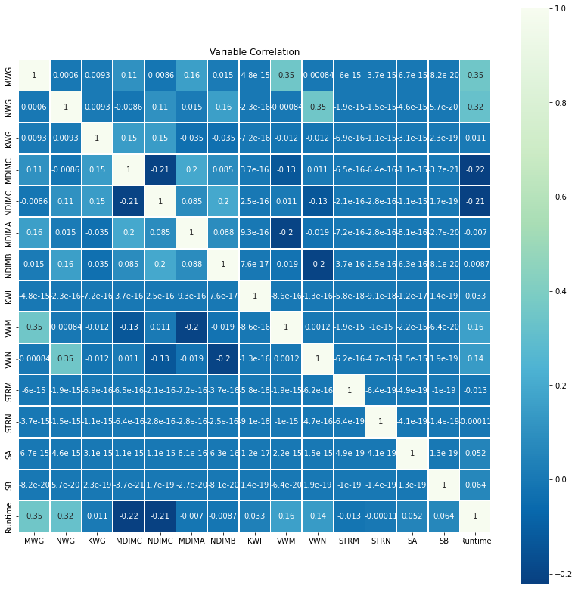
Exploring Data Analysis
Correlation using heat map.

Slide 15
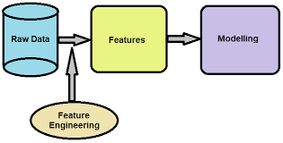
Feature Engineering
Observing the dataset of last four columns of individual data Run's (ms) measured variables are similar to each other, let’s take the mean of that four variables as a target variable.
After feature engineer will go to feature selection i.e., observing 14 independent variables and selecting that variables for an model implementation.

Slide 16
Model Implementation
For an model Implementation considering the data into 80% of train and 20% of test.
(x_train.shape, x_test.shape)=(48320, 14) (193280, 14)

Slide 17
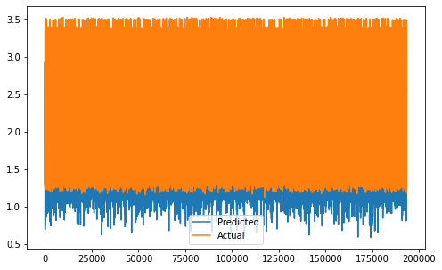
Model Implementation
Algorithms
For this dataset implemented several Machine Learning Regression algorithms as mentioned below:
Linear Regression
Anyhow for this dataset linear regression given less prediction checking with several transition metrics the R2_score given 0.56.
Regularization
Using L1 (Lasso), L2 (Ridge) and Elastic
Net with Hypertuning I got the same
R2_score of Linear Regression 0.56.

Slide 18
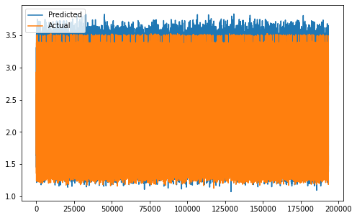
Model Implementation
Polynomial Regression
So I want to try polynomial regression
which gives me somehow better results
then linear regression scores. For poly
regression I got R2_score is 0.81
Decision Tree
I tried another regression called decision tree regression where my R2_score got 0.99. Which may lead to overfit.

Slide 19
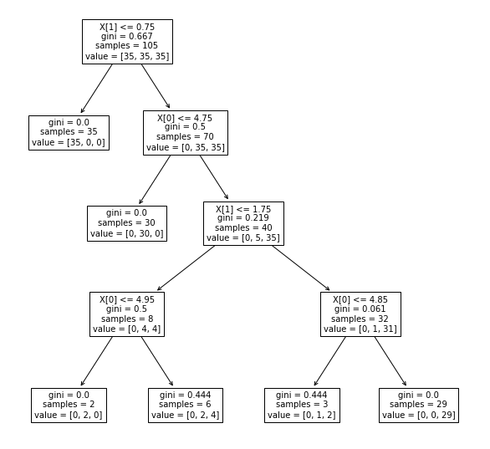
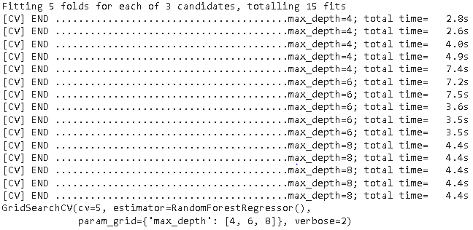
Model Implementation
Random Forest
Implementing the random forest using Hyper parameter tuning with Grid Search. This algorithm gives the best R2_score 0.95.

Slide 20
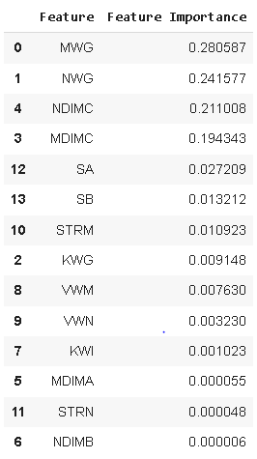
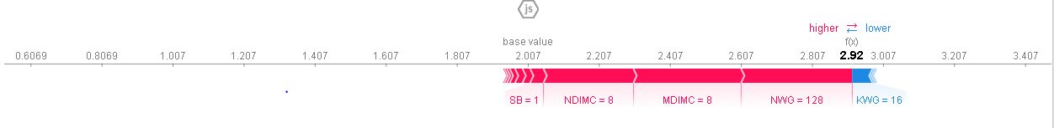
Model
Explainability

Slide 21
Conclusions
SGEMM GPU Kernel Performance is measured on running time by its arithmetic calculation (Matrix A * Matrix B = Matrix C). Using some machine learning regression algorithms implemented to predict the response variable.
Using Multivariate Linear Regression which gives 0.56 R2_score and also all the regularization techniques gives almost the same prediction of linear Regression which includes hyper tuning.
Understanding the dataset (Curvilinear) implemented Polynomial Regression which gives 0.81 R2_score.

Slide 22
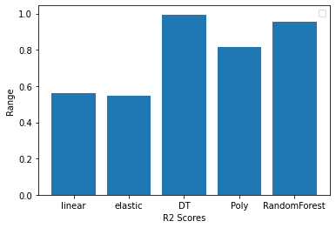
Conclusion
Observed features of objects implemented in a Decision Tree gives 0.99 R2_score which may lead to overfitting.
To control overfitting implemented
Random Forest techniques with
hyperparameter tuning are improved
predicting the output accuracy and
the R2_score is 0.95.

Slide 23

Thank You

